Slide 1

NOIDA INSTITUTE OF ENGINEERING & TECHNOLOGY GREATER NOIDA
Course & Branch Project Management (AOE0761)
Unit 1: Introduction of Project
By
Sonali Sharma
Assistant Professor
Department of PGDM
NIET, GREATER NOIDA

Slide 2
Index
S No | Content
1 | Name of Subject with code, Course and Subject Teacher
2 | Brief Introduction of Faculty member with Photograph
3 | Evaluation Scheme
4 | Syllabus
5 | Branch wise Application
6 | Course Objective(s)
7 | Course Outcome(s)
8 | Program Outcomes (POs)
9 | COs and POs Mapping
10 | Program Educational Objectives (PEOs)
11 | Result Analysis
12 | End Semester Question paper Templates
13 | Prequisite/Recap

Slide 3
Index
S No | Content
14 | Brief Introduction about the Subject with Videos
15 | Unit Content
16 | Unit Objectives
17 | Topic Objectives & Topic Outcome
18 | Lecture related to topic
19 | Daily Quiz
20 | Weekly Assignment
21 | Topic Links
22 | MCQs
23 | Glossary Questions
24 | Old question papers
25 | Expected Questions
26 | Recap of unit

Slide 4
Faculty Profile
Faculty Name: Sonali Sharma
Designation: Assistant Professor
Department: MBA
Email ID: sonali.sharma@niet.co.in
Qualification: M.com, MBA, UGC NET, PhD(Persuing HRM)
Specialization: Human Resource
Teaching Area: HR, Finance, Marketing
Total Experience: 6.5 years
. Subject: Project Management by: Sonali Sharma

Slide 5
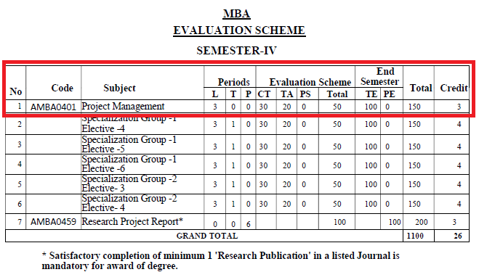
Evaluation Scheme
. Subject: Project Management by: Tarun Maheshwari

Slide 6
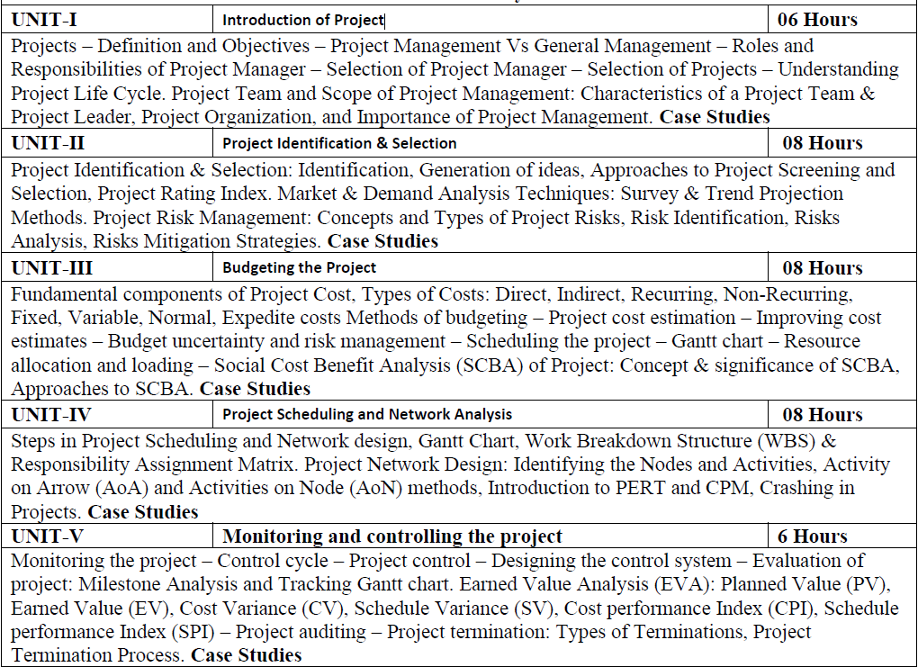
Syllabus
. Subject: Project Management by: Sonali Sharma
s

Slide 7
Branch wise Application
Handling projects.
Evaluating & Monitoring Project Process
Taking necessary and corrective action.
. Subject: Project Management by: Tarun Maheshwari

Slide 8
Course Objectives
To empower the students to get insights into basic concepts of project management.
To create awareness of the roles and responsibilities of the project manager.
To build confident among the students to take up any kind of project.
To sharpen the planning, scheduling, and controlling skills of the students concerning individual projects.
To understand the perspectives in which optimum decisions are to be taken in case of risks with planned activities in the project.

Slide 9
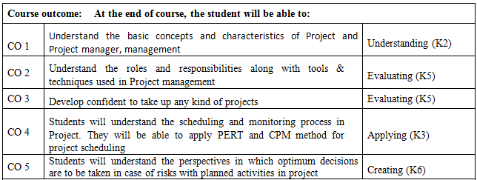
Course Outcomes
. Subject: Project Management by: Sonali Sharma

Slide 10
Program Outcome(s)
1. Apply knowledge of management theories and practices to solve business problems.
2. Foster analytical and critical thinking abilities for data-based decision-making.
3. Ability to develop value-based leadership ability.
4. Ability to understand, analyze, and communicate global, economic, legal, and ethical aspects of business.
5. Ability to lead themselves and others in the achievement of organizational goals, contributing effectively to a team environment.

Slide 11
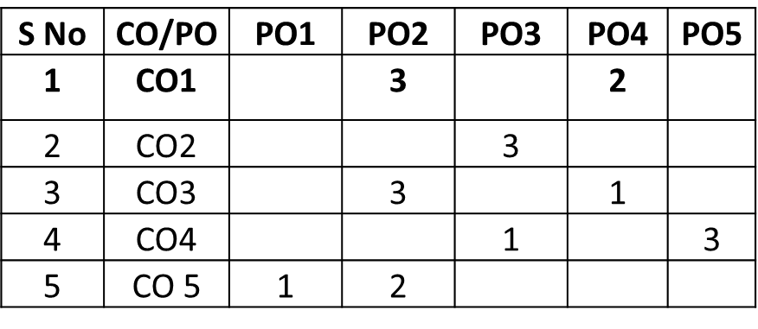
COs and POs mapping
*1=High, *2=Medium, *3=Low

Slide 12
Program Educational Objectives
PEO 1: Graduates of the Management program will have conceptual knowledge, to adapt to the rapidly changing environment, learn new skills and demonstrate application of management principles in a professional work setting.
PEO 2: Graduates will apply appropriate tools for decision making required for solving complex managerial problems in the local or global context.
PEO 3: Graduates of the Management program will exhibit integrity, social responsibility and teamwork.
PEO 4: Graduates will exhibit ethics, communication skills, leadership qualities and entrepreneurial mindset using creativity and innovation.

Slide 13
Result Analysis

Slide 14
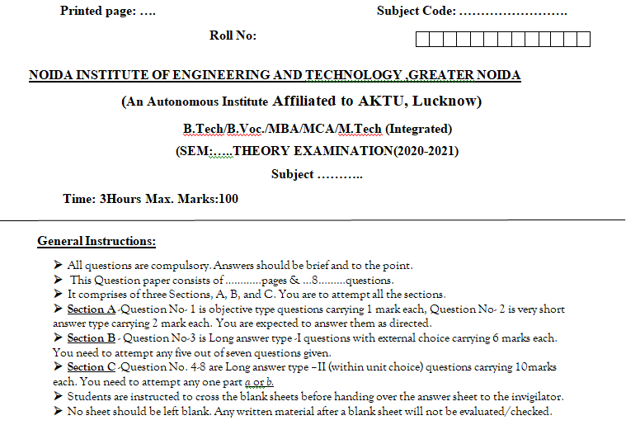
End Semester Question Paper Template

Slide 15
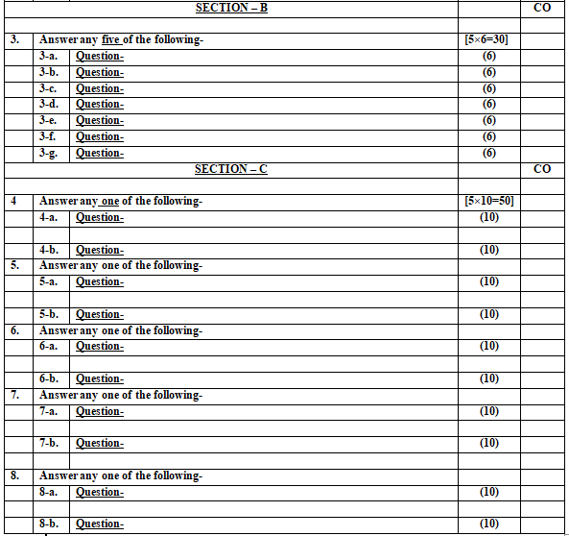
End Semester Question Paper Template

Slide 16
Perquisite/Recap
Understanding of general management

Slide 17
Brief Introduction about the Subject with Videos
Projects are all around us. Virtually every organization runs projects, either formally or informally. Across settings, planning principles and execution methodologies can offer ways in which projects can be run more effectively and efficiently. Project management provides organizations (and individuals) with the language and the frameworks for scoping projects, sequencing activities, utilizing resources, and minimizing risks.
https://www.youtube.com/watch?v=uEREF70j-yI
https://www.youtube.com/watch?v=ewhTgzIQG84&list=PLLy_2iUCG87CBuNhvti0h6W54ZmqrSDMJ&index=5
https://www.youtube.com/watch?v=fDh0K3SYT6A&list=PLLy_2iUCG87CBuNhvti0h6W54ZmqrSDMJ&index=21

Slide 18
Unit Content
Projects – Definition and Objectives – Project Management Vs General Management – Roles and Responsibilities of Project Manager – Selection of Project Manager – Selection of Projects – Understanding Project Life Cycle. Project Team and Scope of Project Management: Characteristics of a Project Team & Project Leader, Project Organization, and Importance of Project Management

Slide 19
Objective of Unit
Understand the meaning of Project and Criteria of Good Project in Project Management.
Identify the various Characteristics of project.

Slide 20
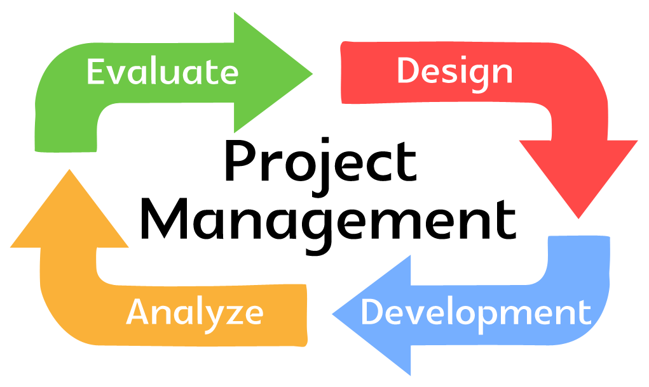
Introduction
A project is a temporary endeavour that produces a unique product, service, or result.
Definitive start and finish dates.
Project management is the application of tools and techniques to organize the project activities to successfully meet the project goals.

Slide 21
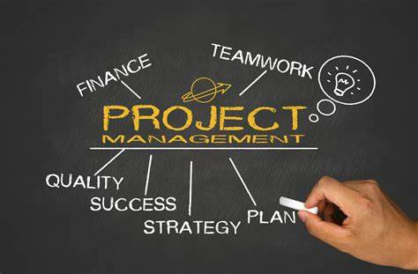
Project
A project is defined as an effort to create or modify a specific product or service.
Projects are temporary work efforts with a clear beginning and end.
Projects can be completely contained within a specific unit or department, or include other organizations and vendors.

Slide 22
More definitions of project
Project Management Institute - 'A project is a temporary endeavor undertaken to create a unique product, service or result.’
Association for Project Management (APM) - 'An endeavor in which human material and financial resources are organized in a novel way to deliver a unique scope of work of given specification often within constraints of cost and time to achieve beneficial changes defined by quantitative and qualitative objectives.‘

Slide 23

Video

Slide 24
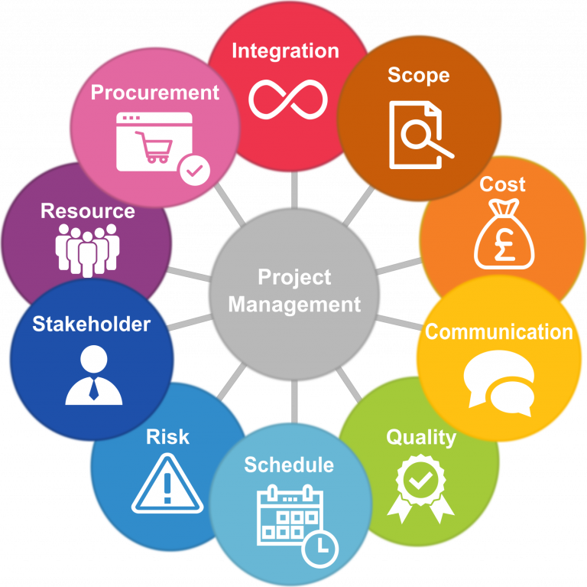
More about project management

Slide 25
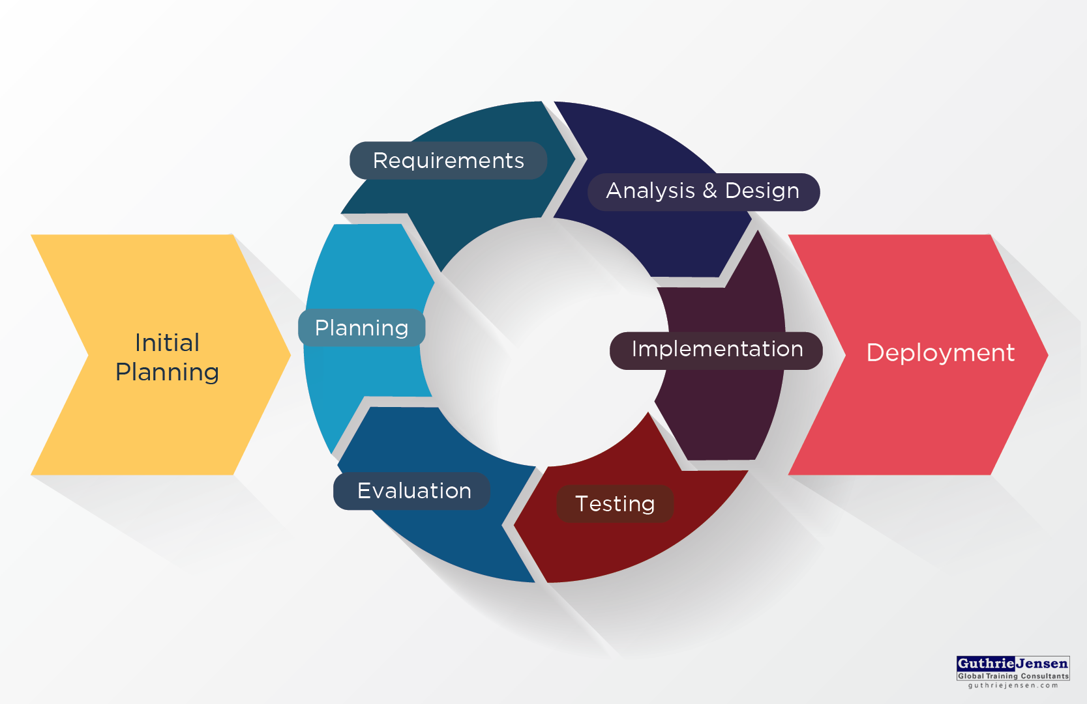
Project Management

Slide 26
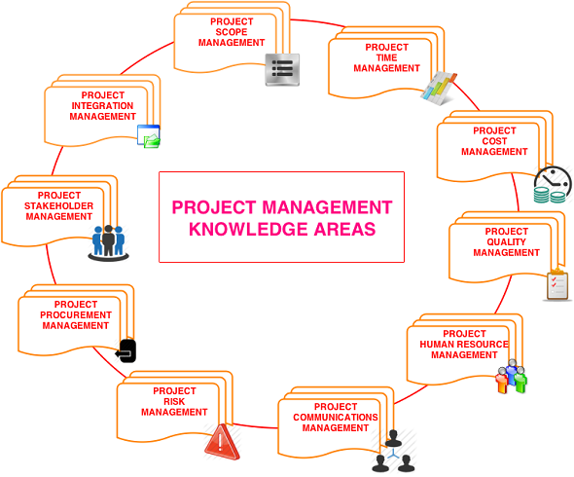
Key Areas Of Project Management
Scope Management
Issue Management
Cost Management
Quality Management
Communications Management
Risk Management
Change Control Management

Slide 27
Features/Characteristics/Components of Project
Scope
Time
Budget
Schedule
Resources
Procurement
Risk
Stakeholders

Slide 28
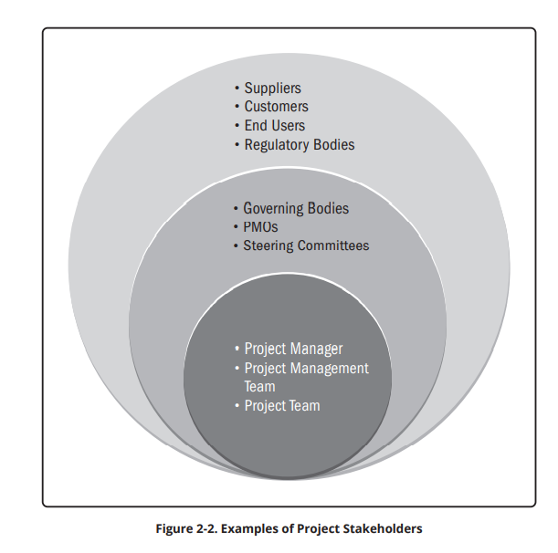
Project Stakeholders

Slide 29
Types of project
Engineering projects encompass civil, electrical, and mechanical engineering, and the final deliverables are physical objects,
Examples: a building, reservoir, bridge, refinery, or pre-production sample. Specialist companies or consortia invariably undertake these types of projects.
Management projects include things like restructuring the organization, preparing for an exhibition, developing an IT system, launching a new marketing campaign, moving offices, or indeed anything where the objective is to produce a result that is not identifiable as a physical item

Slide 30
Basic Terminologies
Portfolio: Projects, programs, subsidiary portfolios, and operations managed as a group to achieve strategic objectives.
Product: An artifact that is produced, is quantifiable, and can be either an end item in itself or a component item.
Program: Related projects, subsidiary programs, and program activities that are managed in a coordinated manner to obtain benefits not available from managing them individually.

Slide 31
Basic Terminologies
Project: A temporary endeavor undertaken to create a unique product, service, or result. The temporary nature of projects indicates a beginning and an end to the project work or a phase of the project work. Projects can stand alone or be part of a program or portfolio.
Project manager: The person assigned by the performing organization to lead the project team that is responsible for achieving the project objectives. Project managers perform a variety of functions, such as facilitating the project team work to achieve the outcomes and managing the processes to deliver intended outcomes.

Slide 32
Basic Terminologies
Project management: The application of knowledge, skills, tools, and techniques to project activities to meet project requirements. Project management refers to guiding the project work to deliver the intended outcomes.
Value: The worth, importance, or usefulness of something. Different stakeholders perceive value in different ways.
Customers can define value as the ability to use specific features or functions of a product.
Organizations can focus on business value as determined with financial metrics, such as the benefits less the cost of achieving those benefits.
Societal value can include the contribution to groups of people, communities, or the environment.

Slide 33
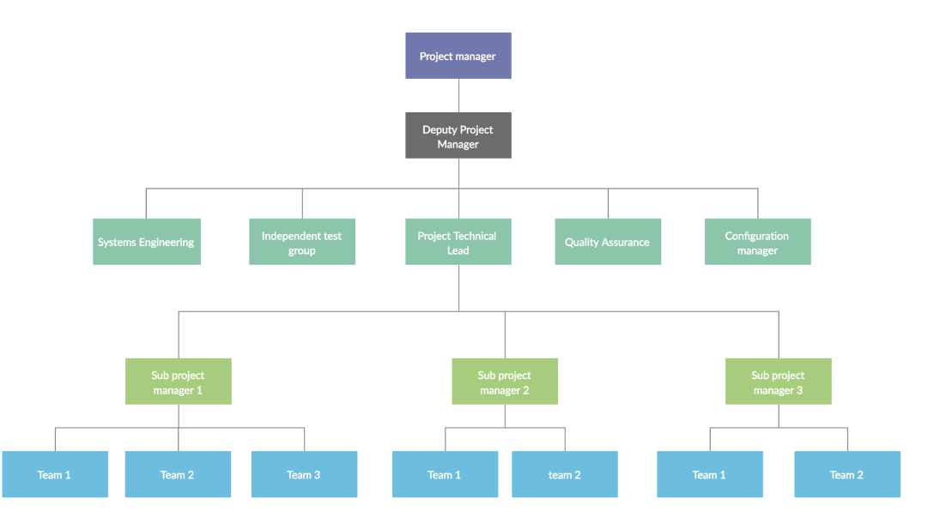
Hierarchy

Slide 34
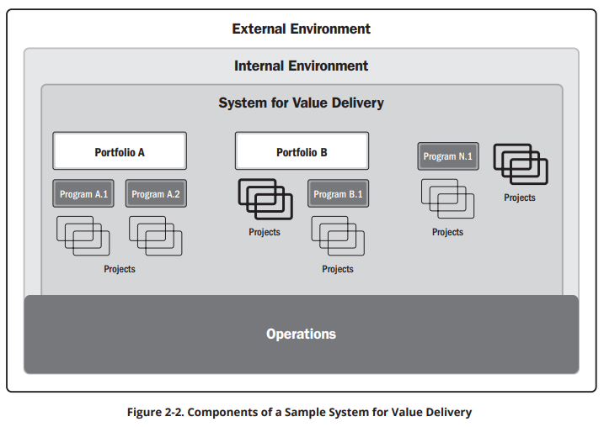
Sample System for value delivery

Slide 35
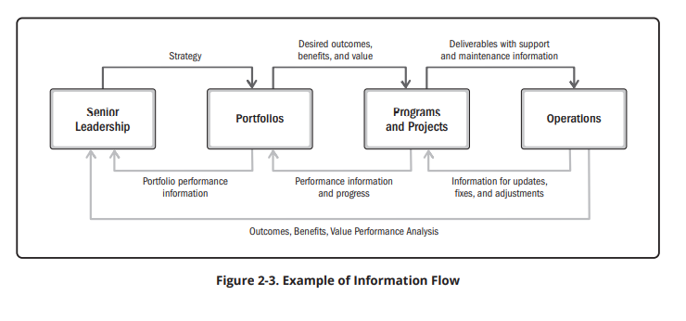
Information Flow

Slide 36
Daily Quiz
Define Project Management.
Identify the various Characteristics of project.
Discuss the types of Project.
Discuss the project team.
Explain the scope of Project Management.
Who leads the team of project- a project manager or a leader?
Is the idea a project?
List the various types of projects.
Define a project.

Slide 37
Recap
The Meaning of Project Involved in Project Management.
Project Team
Project Manager
The Various Characteristics of Project.
The Formulation of Types of Project.
The Project Team.
The Scope of Project Management.

Slide 38
Project Success
Set Expectations: Define the Project
Get Organized: Create the Project Plan
Start at the Top: Gain Executive Support
The Best Teams Deliver the Best Results: Project Team Management
Prepare for the Inevitable: Risk Management

Slide 39
Project Success
Stick to the Plan: Scope Management
Deliver on the Plan: Quality Assurance
Spread the News: Communicate Early and Often
Gain User Acceptance: Change Management
Quantify Results: Measure Project Success

Slide 40
Project can fail due to:
Lack of resource planning
Unclear Goals and Objectives
Lack of project visibility
Communication gaps
Scope creep
Unrealistic expectations

Slide 41
Categories of Project
1. | Administrative | Installing a new accounting system
2. | Construction | Building or road
3. | Computer Software Development | New computer program
4. | Design of Plans | Architectural or engineering plans
5. | Equipment or System Installation | Telephone system or IT system
6. | Event or Relocation | Olympiads or a move into a new building
7. | Maintenance of Process Industries | Petro-chemical plant or electric generating station
8. | New Product Development | New drug or aerospace/defense product
9. | Research | Feasibility study or investigating a chemical

Slide 42
Project vs. Regular Operations
Project
temporary - they have a definitive beginning and end
unique - they are a new undertaking, unexplored ground
Regular Operations
repetitive - they have expected inputs and outputs every time
ongoing - they have a continuous cycle of execution

Slide 43
Daily Quiz
State the difference between project and regular operations.
Illustrate the factors that lead to failure of the project.

Slide 44
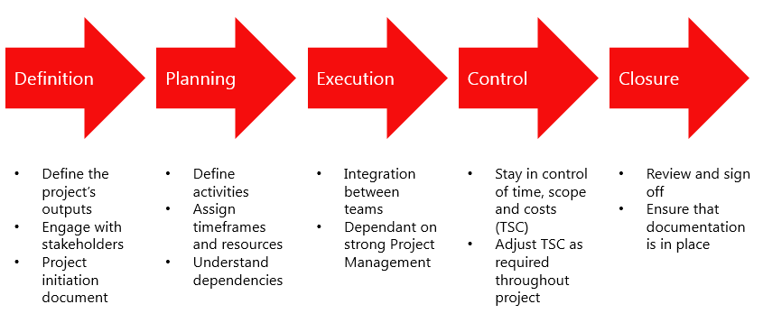
Project Life Cycle

Slide 45
Step 1: Definition
Project manager must prove that the project has value and is feasible.
A project charter, which is a document that conveys what the project is going to deliver, is created. A project brief serves a similar purpose.
This project management stage culminates in a project kickoff meeting, where the team, stakeholders, and other relevant parties are brought together to lay out the project goals, schedule, processes, and the chain of communication.

Slide 46
Step 2: Planning (Generating Concepts)
The project plan must include every component associated with the execution of the project, including the costs, risks, resources and timeline.
The project scope (the work required to complete the project) is defined using a work breakdown structure (WBS).
Project managers often lay out their project plan using a Gantt chart, which provides a visual representation of the entire project. This provides a roadmap for the work until the project reaches its conclusion

Slide 47
Step 3: Executing (Develop A Solution)
The tasks and milestones outlined in the plan are tackled to produce the deliverable to the client’s or stakeholder’s satisfaction.
Along the way, the project manager will reallocate resources as needed to keep the team working. In addition, they will identify and mitigate risks, deal with problems and incorporate any changes.

Slide 48
Step 4: Monitoring And Controlling (Construct and Test Prototype)
Monitoring the progress and performance
Quality control procedures are applied to guarantee quality assurance.
The biggest issues in a project are typically related to three factors—time, cost and scope, which collectively are referred to as the triple constraint.

Slide 49
Step 5: Closing (Evaluate And Present Solution)
The fifth project management phase is project closure, in which the final deliverables are presented to the client or stakeholder.
At this point the project manager and team can conduct a post-mortem to evaluate the lessons learned from the project.
Depending on the project, the closure phase may include handing over control to a different team, such as an operations management team.
In this case, it is the job of the project manager to ensure such a transition occurs smoothly.

Slide 50
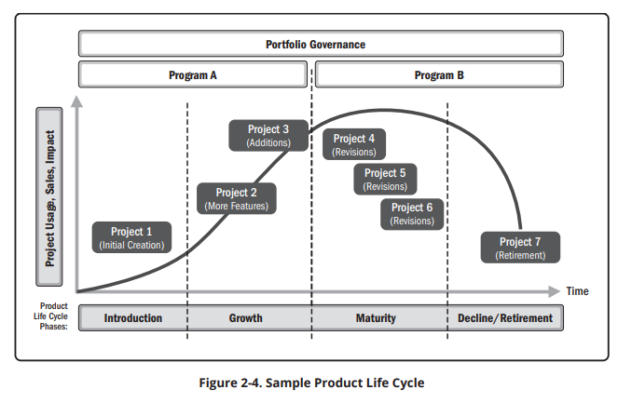
Product and Project Life Cycle

Slide 51
Quiz: Are these Projects?
Building a deck (Yes/No)
Implementing a new system (Yes/No)
Mowing the lawn (Yes/No)
Planning a wedding (Yes/No)
Planning a fundraiser (Yes/No)
Planning a student graduation (Yes/No)

Slide 52
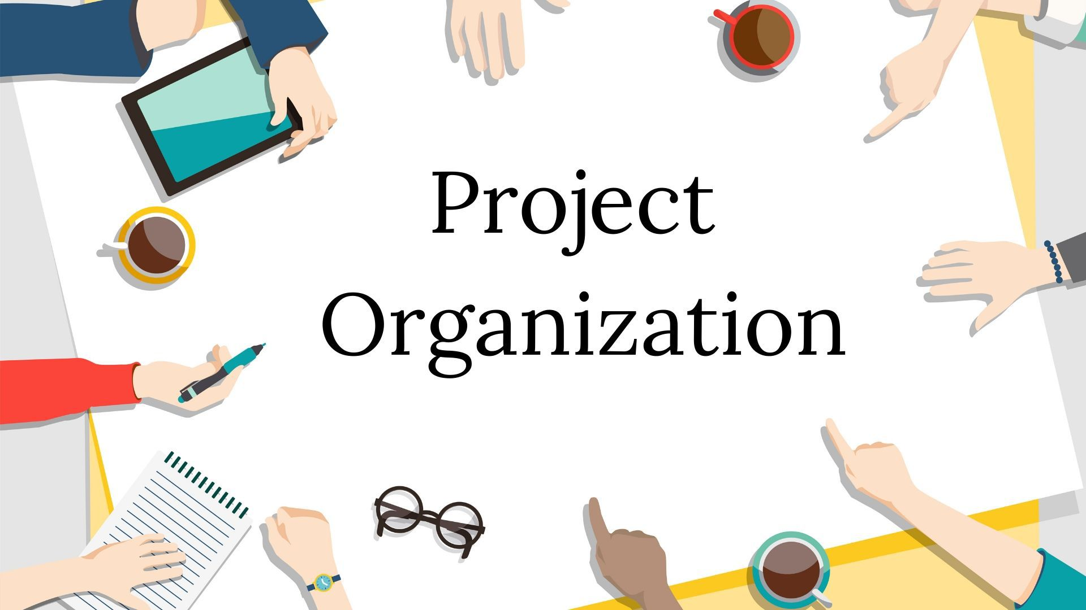
Project Organization
Project organization refers to the style of coordination, communication, and management the project team uses throughout a project lifecycle.
Objective: Create an environment that encourages the development of interactions between team members with very less amount of disruptions, overlaps, and conflicts.
“Project organization is all about thinking ahead.”

Slide 53
Responsibility of Project Organization
Definition of process even maintenance of project process
Process automation
The organization’s role or role of process automation is taken and achieved by a single individual or various other teams.

Slide 54
Types of Project Organizational Structures
Functional is when the organizational departments are grouped by areas of specialization. In this case, the project is usually executed in a silo environment.
Projectized is when the entire organization is organized by the project.
Matrix has teams report to both a functional manager and project manager, sort of a hybrid of the previous two structures.
Organic project organization embraces flexibility.
Virtual is when the project manager is the hub in the network.
Multi-division means that functional groups are decentralized.

Slide 57
Six Considerations Can Help Lend Project Success to Any Organizational Setup
1. Clear project requirements
2. Alignment among stakeholders
3. Resources available and needed
4. Communication planning
5. Review and feedback process
6. What could go wrong and possible corrections

Slide 58
Case Study: The Enterprise Resource Planning Project

Slide 59
MCQs
Which of the following is not a project management goal?
Keeping overall costs within budget
Delivering the software to the customer at the agreed time
Maintaining a happy and well-functioning development team
All of the above
2. The process each manager follows during the life cycle of a project is known as:
Project Management
Manager life cycle
Project Management Life Cycle
All of the mentioned

Slide 60
MCQs
3. Quality planning is the process of developing a quality plan applicable for.
Team
Project
Customers
project manager
4. Which of the following is an incorrect activity for the configuration management of a software system? A. Internship management B. Change management C. Version management D. System management

Slide 61
Assignment Questions
Fill in the blanks:
The successful ………………… is all about structure, control, sufficient attention to detail and continuously driving action.
A project can only be successful when there is no conflict between the ………………… and the local populace.
Project Management is quite often the province and responsibility of an individual …………………
The project manager needs to be an ………………… expert who can motivate the workforce by training and promoting leadership among them.
5. Every project has some elements that are ……………………

Slide 62
Assignment Questions
Discuss Project Management as a profession.
What do you know about Project Life Cycle? Support your answer with a suitable example.
Points to be kept in mind:
Marks for fill ups (0.5 each)
Question 1 carry 2.5 marks
question 2 carries 5 marks
Word limit for 1 max.250 words limit
2 question max. 500 words limit

Slide 63
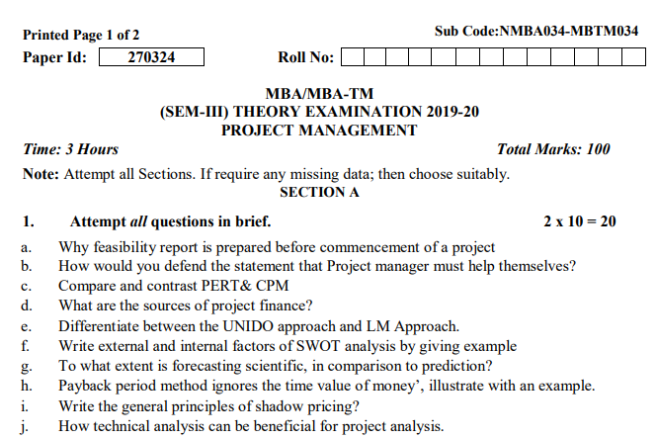
Old Question Papers

Slide 64
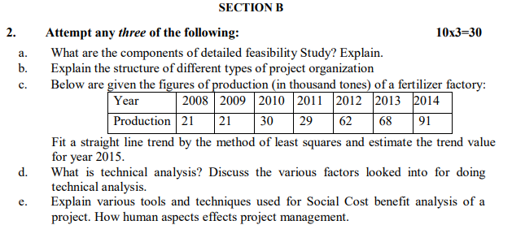
Old Question Papers

Slide 65
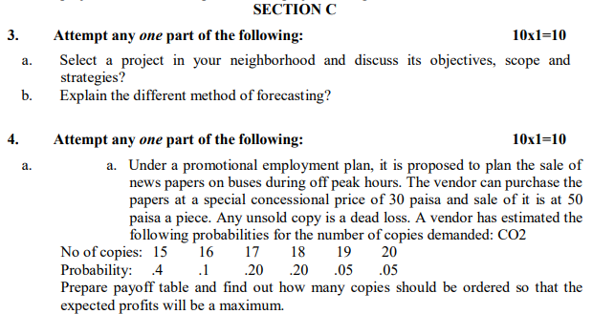
Old Question Papers

Slide 66
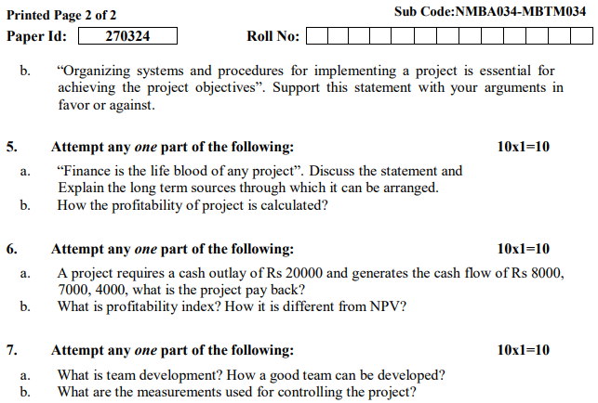
Old Question Papers

Slide 67
Expected Questions
Q1. Discuss the project. elaborate are the components of the project management process.
Q2. Describe various Tools and techniques of project management.
Q3. Discuss the characteristics of a Project leader.
Q4. Explain the term 'project organization’.
Q5. Explain the project life cycle with a diagram.

Slide 68
Video Links
https://www.youtube.com/watch?v=39_O-AnzTQg
https://www.youtube.com/watch?v=BOU1YP5NZVA
https://www.youtube.com/watch?v=ZKOL-rZ79gs
https://www.youtube.com/watch?v=RjOA7AxOVj8&list=PLPjSqITyvDeX77O9g4E_lgJbAmLK5SFu6
https://www.youtube.com/watch?v=xzkgMVDRHi4&t=1s
https://www.youtube.com/watch?v=1Fqe_7rn3Vs
https://www.simplilearn.com/what-is-a-deliverable-article
https://www.projectmanager.com/training/write-scope-work
https://plan.io/blog/scope-of-work/
https://www.projectmanager.com/blog/milestones-project-management
https://www.teamgantt.com/blog/the-how-and-why-of-using-milestones-in-your-project-plan
https://www.projectsmart.co.uk/top-10-qualities-project-manager.php
https://pmtips.net/article/10-characteristics-of-successful-project-teams
https://www.sinnaps.com/en/project-management-blog/importance-of-project-management

Slide 69
References
Books:
Larsen, E.W., Gray C.F., & Joshi, R. (2021). Project management: The Managerial process. McGraw Hill.
Chandra, P. (2019). Projects: Planning, Analysis, Selection, Financing, Implementation and Review. McGraw Hill.
REFERENCE BOOK:
Nagarajan, K. (2017). Project Management. New Age International Pvt. Ltd.
Paneerselvam, R., & Senthilkumar, P. (2013). Project Management. Prentice Hall India Learning Pvt. Ltd.
Pinto, J.K. (2020). Project Management. Global EduTech.
Desai, V. (2016). Project Management. Himalaya Publishing House.

Slide 70
Recap of the unit
A project is temporary- It has a defined beginning and end in time, and therefore defined scope and resources.
Project Life Cycle is a series of activities which are necessary to fulfill goals or objectives.
The application of knowledge, skills, tools, and techniques to project activities to meet project requirements. Project management refers to guiding the project work to deliver the intended outcomes.

